Slide 1


RegenCafé
CTO: Venus, CFO: Vanessa, and CEO: Bianca

Slide 2
Basis of our service:
We want to alter the chemical composition of the coffee and cocoa plant to resist effects of climate change

Slide 3
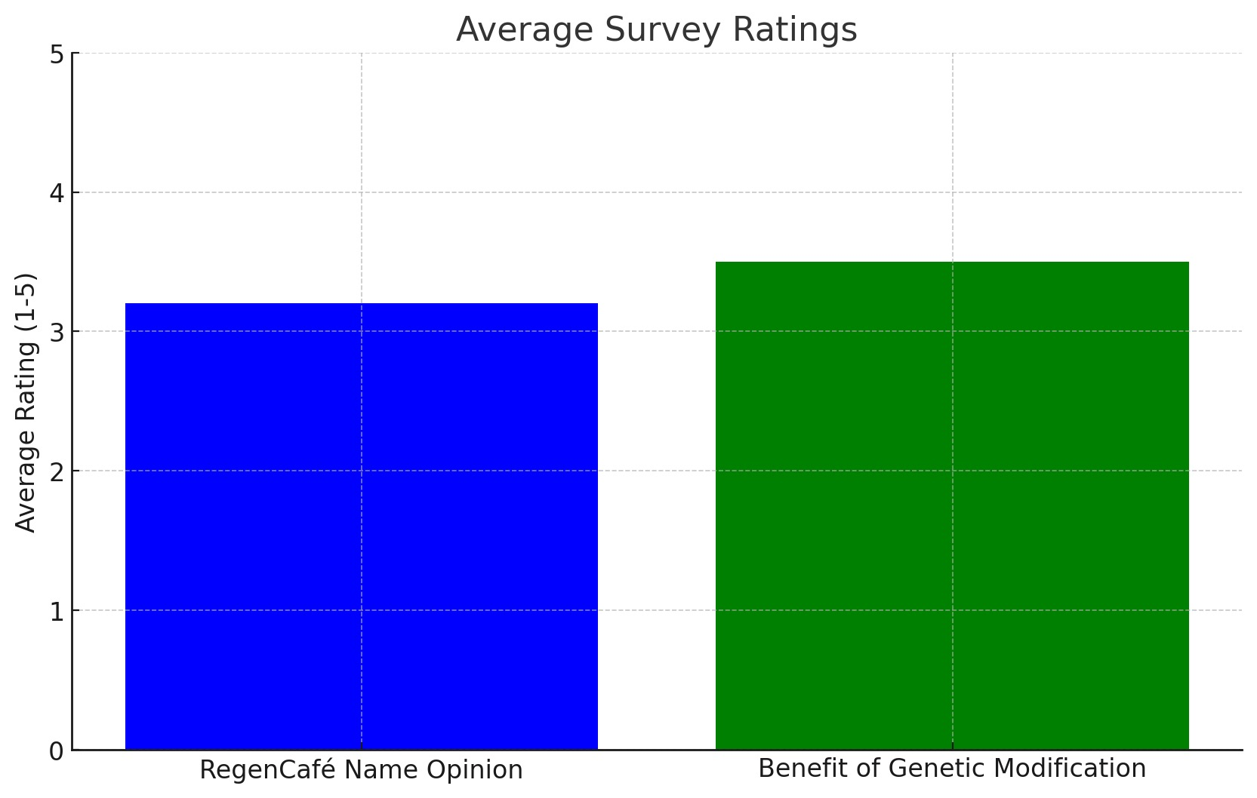
We surveyed about 10 people and their responses are listed to the right:
We found that most people found the company name to just be okay, but we saw that people had a more positive outlook when it came to the benefit of genetic modification

Slide 4
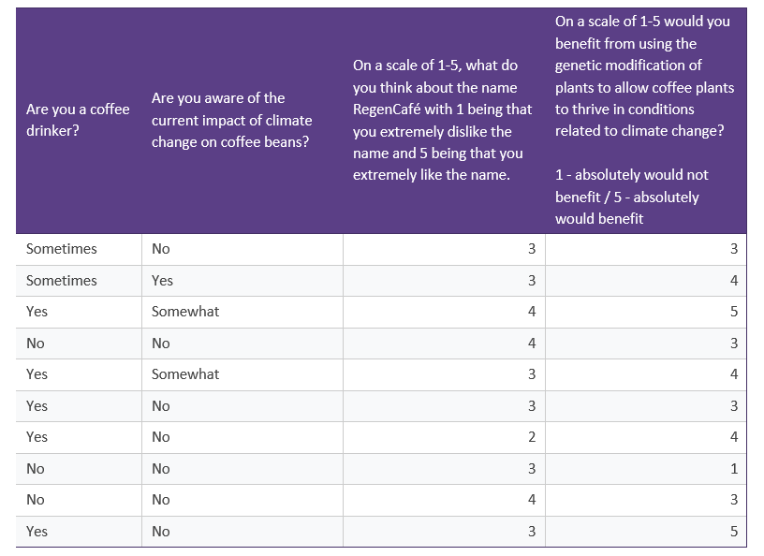
These are the responses from our poll we sent out:

